Slide 1
A Design Process
Introduction to Engineering Design
© 2012 Project Lead The Way, Inc.

Slide 2
The Design Process
What Is Design?
What Is a Design Process?
Design Process Examples
Design Process Used in IED
© 2012 Project Lead The Way, Inc.

Slide 3
What Is Design?
The word “design” is often used as a generic term that refers to anything that was made by a conscious human effort.
Design is also a process that is used to systematically solve problems.
© 2012 Project Lead The Way, Inc.
Notes:
Talk to students about how they use design every day. The process for getting ready for school is one example.

Slide 4
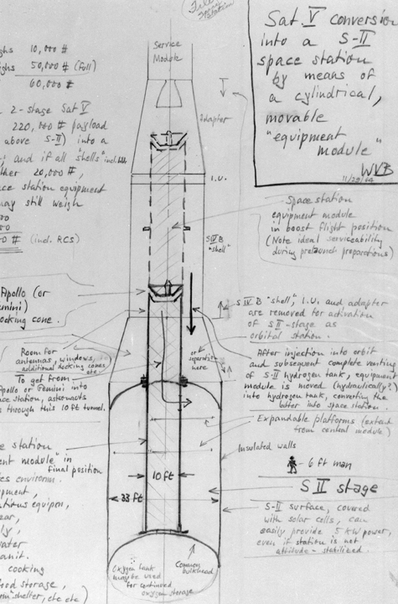
What Is a Design Process?
A design process is a systematic problem-solving strategy, with criteria and constraints, used to develop many possible solutions to solve or satisfy human needs or wants and to narrow down the possible solutions to one final choice.
– ITEA Standards for Technological Literacy
Images courtesy of NASA
© 2012 Project Lead The Way, Inc.
Notes:
The first image is a von Braun sketch from 1964.
The second is an engineer in 1971 working with a Saturn V model.

Slide 5
Design Process
Various design processes are used across different technical fields. The following are examples.
© 2012 Project Lead The Way, Inc.

Slide 6
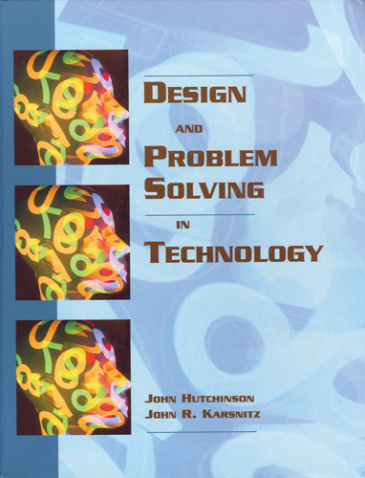
Design Process Example
Identify problems and opportunities
Frame a design brief
Investigate and research
Generate alternative solutions
Choose a solution
Developmental work
Model and prototype
Test and evaluate
Redesign and improve
Design and Problem Solving in Technology
© 2012 Project Lead The Way, Inc.
Notes:
Several different design processes are used successfully in both industry and academia.

Slide 7
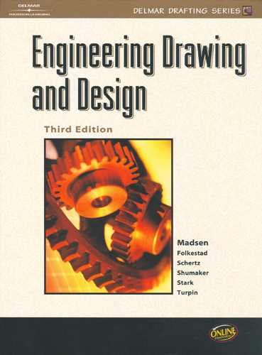
Design Process Example
Identify the need
Define the criteria
Explore/research/investigate
Generate alternate solutions
Choose a solution
Develop the solution
Model/prototype
Test and evaluate
Redesign and improve
Engineering Drawing and Design
(3rd edition)
© 2012 Project Lead The Way, Inc.

Slide 8
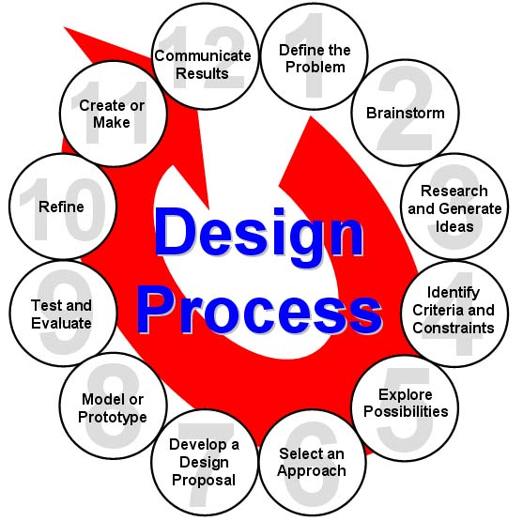
Design Process Example
ITEA Standards for Technological Literacy
Define the problem
Brainstorm
Research and generate ideas
Identify criteria and specify constraints
Explore possibilities
Select an approach
Develop a design proposal
Make a model or prototype
Test and evaluate the design using specifications
Refine the design
Create or make solution
Communicate processes and results
© 2012 Project Lead The Way, Inc.
Notes:
Many different design processes guide professionals in developing solutions to problems. The example that you see here is the design process implemented in PLTW courses.

Slide 9
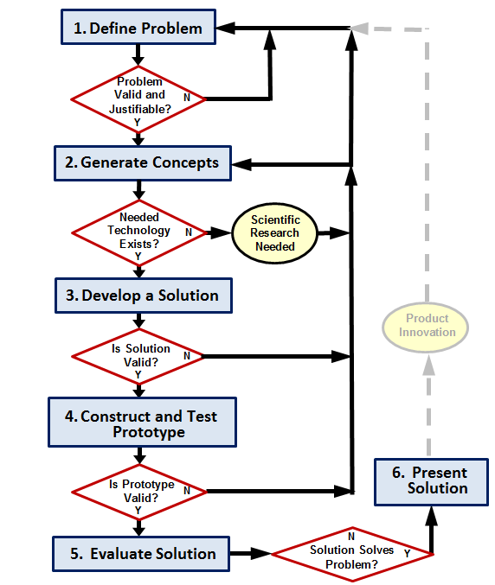
Design Process used in IED
Define the Problem
Generate Concepts
Develop a Solution
Construct and Test a Prototype
Evaluate the Solution
Present the Solution
This design process was developed based on the University of Maryland - College Park - IRB Research Project
© 2012 Project Lead The Way, Inc.

Slide 10
Design Process
Design process used in IED is an example of one design process
Many design processes exist and are effective
Consistently applying a single clearly defined design process provides a basis for understanding
© 2012 Project Lead The Way, Inc.

Slide 11
Define the Problem
Identify a problem
Validate the problem
Who says it is a problem?
Needs and wants
Prior solutions
Justify the problem
Is the problem worth solving?
Create design requirements (specifications)
Criteria and constraints
Design Brief
© 2012 Project Lead The Way, Inc.
Notes:
An acceptable problem is one for which there is no known solution, or one for which there is a solution that can be significantly improved upon. It must be valid (i.e., not a problem because the student says so, but because other credible sources agree that it is a problem) and justifiable (i.e., the effort to solve the problem is warranted based on need and cost).

Slide 12
Define the Problem
Design Brief
A written plan that identifies a problem to be solved, its criteria, and its constraints.
Used to encourage thinking of all aspects of a problem before attempting a solution.
© 2012 Project Lead The Way, Inc.

Slide 13
Define the Problem
Identify a problem
Validate the problem
Who says it is a problem?
Needs and wants
Prior solutions
Justify the problem
Is the problem worth solving?
Create design requirements (specifications)
Criteria and constraints
Design Brief
In some cases, if the problem is not valid or justifiable, the designer must define a new problem.
© 2012 Project Lead The Way, Inc.

Slide 14
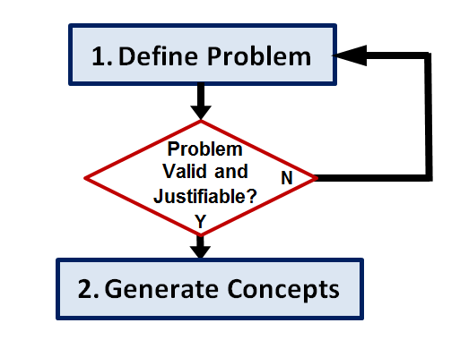
Generate Concepts
Research
Brainstorm possible solutions
Consider additional design goals
Apply STEM principles
Select an approach
Decision Matrix
© 2012 Project Lead The Way, Inc.
Notes:
When generating concepts the designer should research past solutions and brainstorm new ideas. During the brainstorming process, additional design goals that will enhance the design may become apparent. As in all steps of the Design Process, the designer should apply STEM (science, technology, engineering, and mathematics) principles.
Once you have generated multiple possible solutions, narrow your efforts to one (or a few) solution paths. One method of selecting an approach is the use of a Decision Matrix.

Slide 15
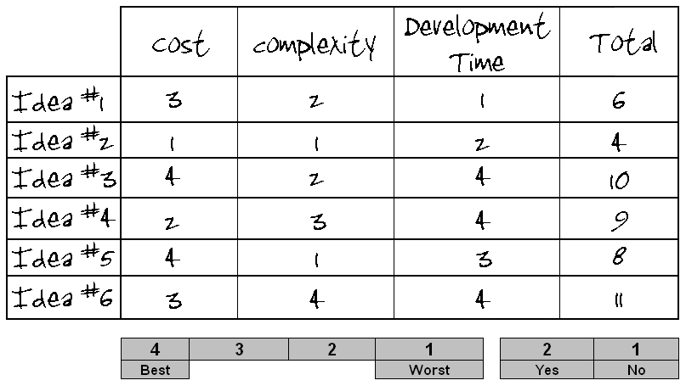
Generate Concepts
Decision Matrix
A tool used to compare design solutions against one another, using specific criteria.
© 2012 Project Lead The Way, Inc.

Slide 16
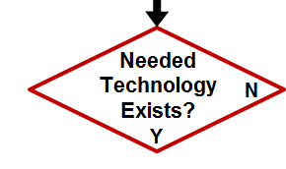
Generate Concepts
Research
Brainstorm possible solutions
Consider additional design goals
Apply STEM principles
Select an approach
Decision Matrix
If the technology necessary to develop the solution does not exist, scientific research may be necessary to pursue a solution.
© 2012 Project Lead The Way, Inc.
Notes:
If technology does not exist that would allow development of the solution path selected, you believe that alternate concepts can be developed with available technology, you may choose another concept that you have already generated or continue to brainstorm in step 2. However, if it appears that the problem may not be solvable at all with existing technology, you may return to step 1 to redefine the problem. One option is to define a problem that will lead to development of the technology necessary for a solution to the original problem.
Note that, in general, a flow chart will not include a flow path that diverges without a decision box, as is the case here when returning to an earlier step. When returning to an earlier step, the designer must decide the most appropriate step to which to return.

Slide 17
Develop a Solution
Create detailed design solution
Justify the solution path
Technical Drawings
© 2012 Project Lead The Way, Inc.

Slide 18
Develop a Solution
Technical Drawings
Drawings that provide technical information necessary to produce a product.
material, size, shape
assembly, if necessary
© 2012 Project Lead The Way, Inc.

Slide 19
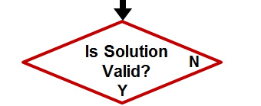
Develop a Solution
Create detailed design solution
Technical Drawings
Justify the solution path
If a solution is found to be invalid or cannot be justified, the designer must return to a previous step in the design process.
© 2012 Project Lead The Way, Inc.

Slide 20
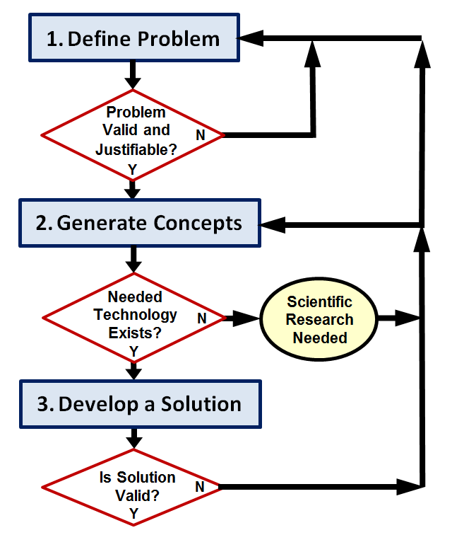
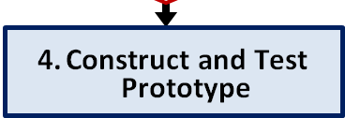
Construct and Test a Prototype
Construct a testable prototype
Plan prototype testing
Performance
Usability
Durability
Test prototype
collect test data
analyze test data
Test Report
© 2012 Project Lead The Way, Inc.

Slide 21
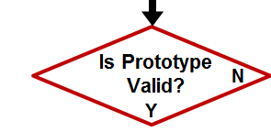
Construct and Test a Prototype
Construct a testable prototype
Plan prototype testing
Performance
Usability
Durability
Test prototype
collect test data
analyze test data
Test Report
If a testable prototype cannot be built or test data analysis indicates a flawed design, the designer must return to a previous step of the design process.
© 2012 Project Lead The Way, Inc.

Slide 22
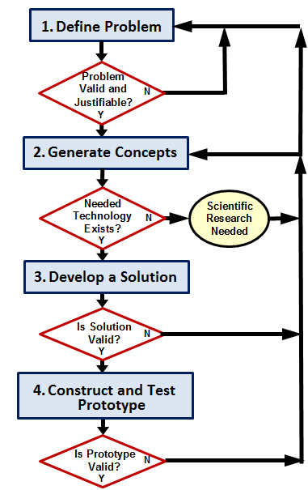
Evaluate the Solution
Evaluate solution effectiveness
Reflect on design
Recommend improvements
Optimize/Redesign the solution
[Return to prior design process steps, if necessary]
Revise design documents
Project Recommendations
© 2012 Project Lead The Way, Inc.

Slide 23
Evaluate the Solution
Evaluate solution effectiveness
Reflect on design
Recommend improvements
Optimize/Redesign the solution
[Return to prior design process steps, if necessary]
Revise design documents
Project Recommendations
© 2012 Project Lead The Way, Inc.

Slide 24
Evaluate the Solution
Does the solution solve the problem?
If not, the designer must return to a previous step of the design process.
© 2012 Project Lead The Way, Inc.

Slide 25
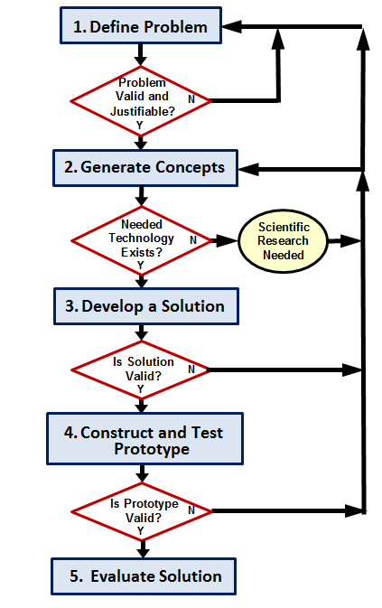
Present the Solution
Document the project
Project Portfolio
Communicate the project
Formal Presentation
© 2012 Project Lead The Way, Inc.

Slide 26
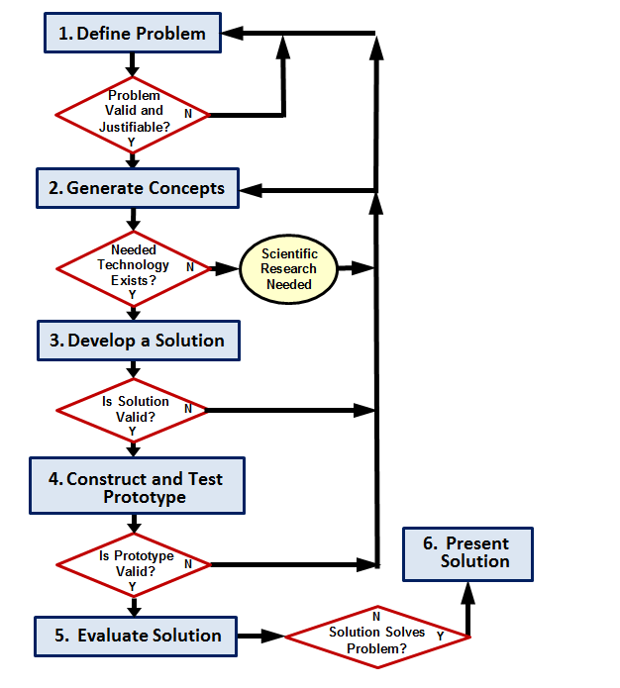
Design Process
Iterative
a process that repeats a series of steps over and over until the desired outcome is obtained
© 2012 Project Lead The Way, Inc.
Notes:
Although we have presented a design process in a somewhat linear fashion, the path from identifying a problem to presenting a solution is rarely straightforward. Designers must evaluate, reflect, redefine, and redesign throughout the process. It is common to repeat steps of the design process several times before an optimal solution is found.

Slide 27
A Design Process
Product improvement or redesign will require the designer to repeat the design process.
Product Innovation
© 2012 Project Lead The Way, Inc.

Slide 28
Image Resources
National Aeronautics and Space Administration (NASA). (n.d.). NASA image exchange. Retrieved from http://nix.nasa.gov/.
© 2012 Project Lead The Way, Inc.

