Slide 1
Statistical Analysis with Excel
Notes:
[It is recommended that students work through the Excel statistical analysis presented here as you present this slide show. You may want to have students individually open Excel on their computer prior to beginning this slide show.]

Slide 2
Spreadsheet Programs
First developed in 70s
VisiCalc
Dan Bricklin and
Bob Frankston
Operated on Apple II
Not patented
Excel based on earlier spreadsheet
Notes:
The first spreadsheet was invented by Dan Bricklin and Bob Frankston and was called VisiCalc. Prior to electronic spreadsheets, much of the work of data storage and analysis was done using paper spreadsheets and calculators or mainframe computers which did not provide flexibility to the user.
VisiCalc was designed to operate on an Apple II computer. The program was sold to Lotus in the 80s. Bricklin and Frankston never patented their spreadsheet because software patents were rare in the 70s.
Excel was developed from earlier spreadsheets.

Slide 3
Purpose of a Spreadsheet
Store raw data
Make calculations
Analyze data
Create charts to represent data

Slide 4
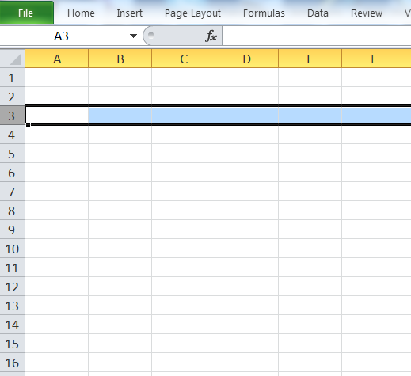
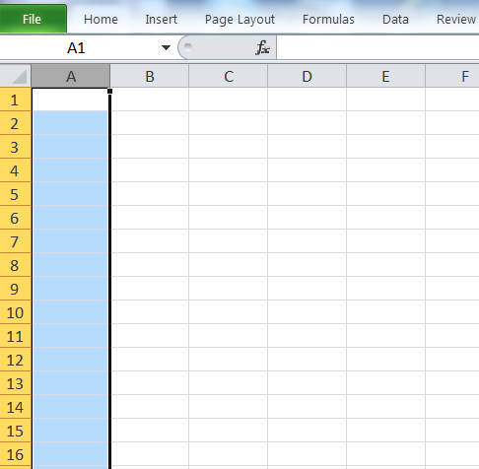
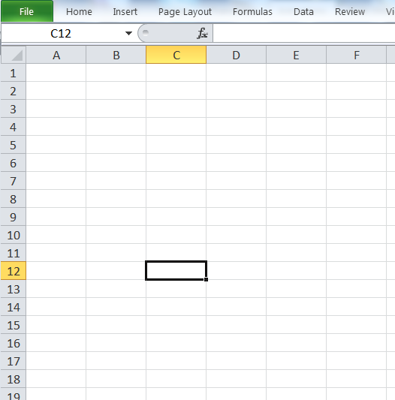
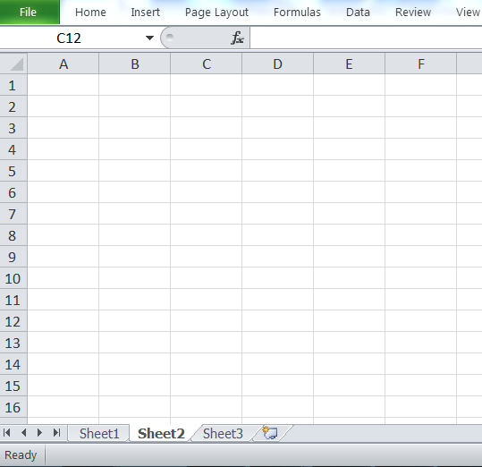
Basics of Excel
Column labels are letters – A, B, C
Row labels are numbers – 1, 2, 3
A cell is the intersection of a column and row – C12
Worksheet
all of the cells on a “page”
Workbook
collection of worksheets
Excel file

Slide 5
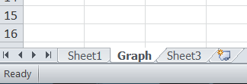
Basics of Excel
Change worksheet name
Double click on sheet name
Type new name
Enter

Slide 6
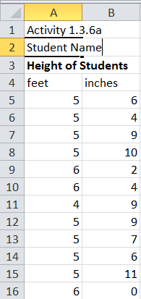
Store Raw Data
Create appropriate heading(s) for data
Input data
Type by hand
Copy from electronic table
Data array
Row
Column
Table
Input height data as shown.
Notes:
Data can be input by typing in the values, or, in some cases, the data can be copied and pasted from tables within other documents or websites.
Data can be input in a column, a row, or a block of data. Any range of cells, whether a column, row, or block (including multiple rows and columns) is called a data array.
In this example, height data was collected from a class and input by hand in columns. The feet portion of the measurement was input separate from the inch portion so that the measurements could be converted to decimal feet. [Click and allow students time to input the data.]

Slide 7
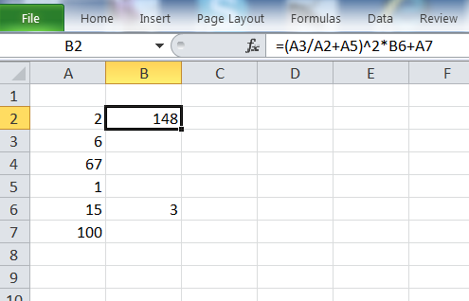
Calculations
Cell designations used to indicate values
Order of operations
Parentheses ( )
Exponents ^
Multiply *
Divide /
Add +
Subtract –
Formula Bar
$${\left(\frac{6}{2}+1\right)}^{2}∙3+100$$
16
148
48
3
4
Notes:
Calculations in Excel follow the same order of operations you learned in math class. The symbols used for the basic math operations are shown. Note that exponents are indicated with the carrot, multiplication with the star (Cap 8), and division with the backward slash.
For example, a calculation has been inserted in cell B2. When you click on the cell [click], the formula that was typed into the cell is shown in the formula bar [click]. When you substitute the cell values into the formula, you get [click].
To follow the order of operations in this example, evaluate the expression within the parentheses. Perform the division first [click], then the addition [click] to get 4.
Then square the result, which gives 16 [click]. Next, multiply by 3 to get 48 [click].
Finally add 100 so that the result is 148 [click]. This will be the value returned in cell B2.

Slide 8
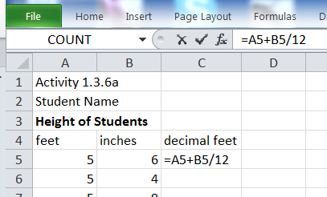
Calculations
Formula Bar
Always begin with =
Use arrow keys or click in cell to select cells for values in formula
Arrow left to A5
Type +
Arrow left to B5
Type /
Type 12
Enter
Input a formula to calculate height in decimal feet for the first data entry.
Notes:
Use the height data presented. Create a formula in cell C5 to convert the height measurements to decimal feet.
[Click and allow students to input the conversion calculation.]

Slide 9
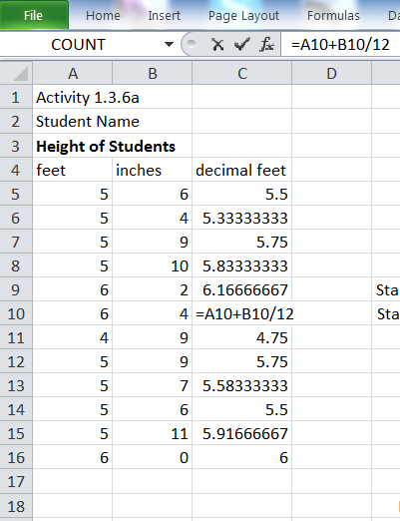
Calculations
To copy a formula
Select cell to copy
Right click
Copy
Select the range of cells to copy to
Right click
Paste
Create a heading and copy formula to appropriate cells.
Notes:
Copy the formula from C5 to the necessary cells to convert all height data to decimal feet.
Note that the formula in each cell reflects relative cell addresses. That is, the cell address in the formula changes with the row number. This is how Excel applies the copy command by default. There is a way to make the cell address permanent so that it remains the same when the formula is copied, but we will not discuss that here.
[Allow students to copy the formula to the necessary cells.]

Slide 10
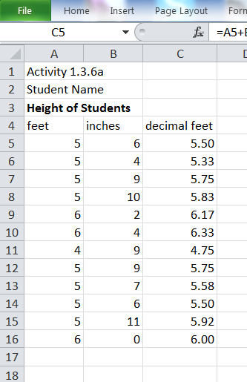
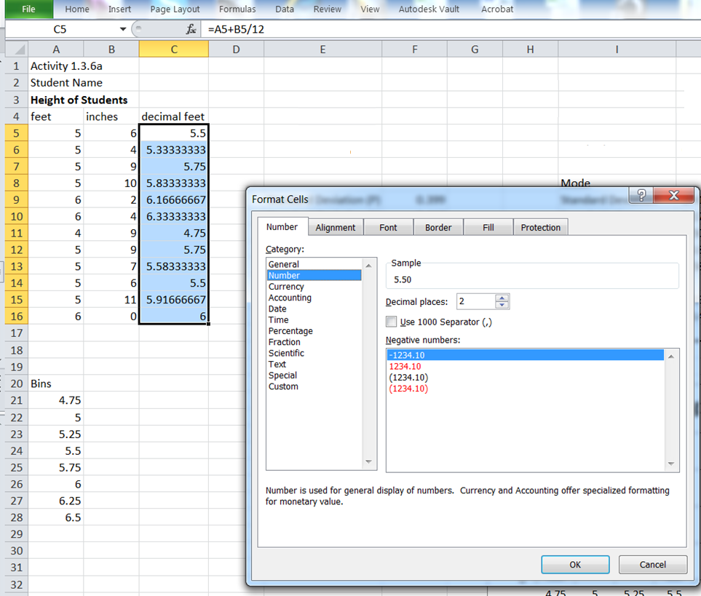
Raw Data and Calculated Values
Format cells
Select data range
Right click within range
Select Format Cells
Adjust format
Number
Decimal places
Alignment
Horizontal
Change format of height to 2 decimal places.
Notes:
To dictate the correct format for the data, [read bullets as students follow along in spreadsheet].
Change the format of the measurements in decimal feet to 2 decimal places.

Slide 11
Calculations
Functions
Defined mathematical calculation
Function | Excel command
Addition of numbers | SUM
Mean | AVERAGE
Median | MEDIAN
Standard Deviation (population) | STDEV.P
Mode (unimodal) | MODE.SNGL
Minimum | MIN
Maximum | MAX
Notes:
Excel can perform many common calculations using functions. A function is just a predefined mathematical calculation. In general, you must provide input information so that Excel can perform the calculation and output the result.
[click] For example, to have Excel calculate the mean (or median, or sum, etc.) of a set of numbers, you must provide the set of numbers.

Slide 12
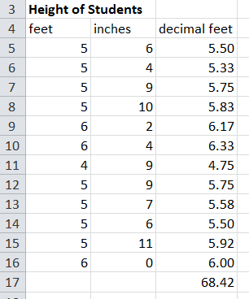
Calculations
Functions
SUM (array)
Gives the sum of an array
Find the sum of the heights in decimal feet.
Select the cell for output
Type =
Type SUM(
Select the range of numbers to sum
Enter
Notes:
Note that the information in the parenthesis must be supplied by the user. To input an array, simply select the range of numbers on which you want to perform the calculation.
To sum a column of numbers, select the cell in which you would like the sum to appear.
Type = SUM(
Then you must identify the numbers for which you would like the sum. Therefore, select the range of cells containing the set of numbers. Then depress the Enter key. The sum of the range of numbers will be displayed.
The same process is followed for other functions.

Slide 13
Functions
Use functions to find the following statistics for the set of height measurements
Mean
Mode
Standard Deviation (population)
Minimum
Median
Maximum

Slide 14
Frequency Chart and Histogram
Frequency Chart
indicates the frequency of occurrence within a class interval
Histogram
graphical representation of the Frequency Chart
Notes:
[Allow students time to input bin values.] Note that the class interval boundaries are typically chosen such that the boundary values contain one decimal place more than the measurement values. For simplicity, we will use zero in the last decimal place.

Slide 15
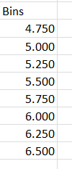
Frequency Chart and Histogram
Select class intervals
Use 0.250 ft intervals for height data
Define Bin values
Bins give the boundary point between class intervals
Values less than or equal to bin value (but greater than previous bin value) are counted
Notes:
[Allow students time to input bin values.] Note that the class interval boundaries are typically chosen such that the boundary values contain one decimal place more than the measurement values. For simplicity, we will use zero in the last decimal place.

Slide 16
Frequency Chart and Histogram
Select the Data Analysis Tool
Data tab > Analysis panel
Notes:
[Allow students time to input bin values.]

Slide 17
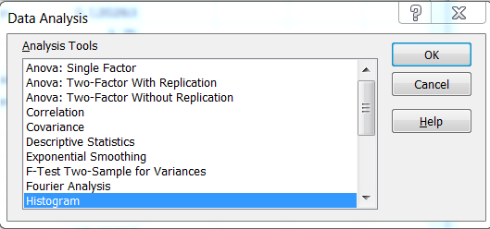
Frequency Chart and Histogram
Select the Data Analysis Tool
Data tab > Analysis panel
Choose Histogram tool
OK
Notes:
[Allow students time to input bin values.]

Slide 18
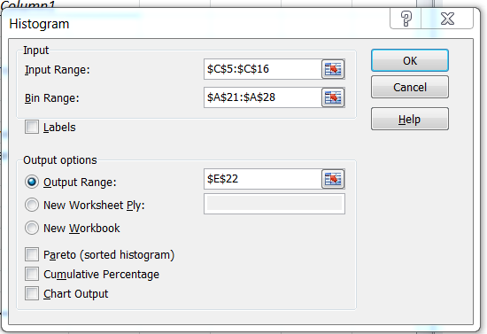
Frequency Chart and Histogram
Select the Data Analysis Tool
Data tab > Analysis panel
Choose Histogram tool
OK
Select Input Range
Select Bin Range
Choose Output Range
Select a cell on the worksheet
OK
Notes:
[click through arrow display and allow students time to complete steps.]
The result should be a frequency chart similar to this. [click]

Slide 19
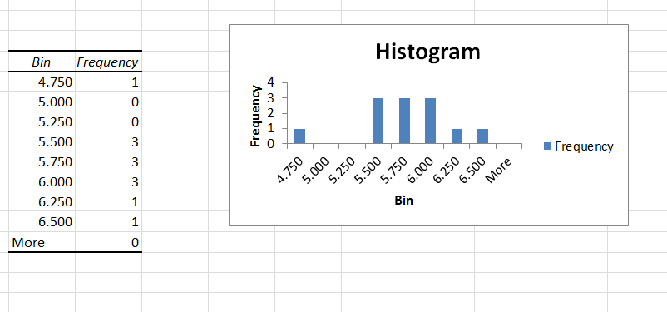
Frequency Chart and Histogram
Histogram
Frequency Chart
Notes:
This is a version of the output that is generated for this data.

Slide 20
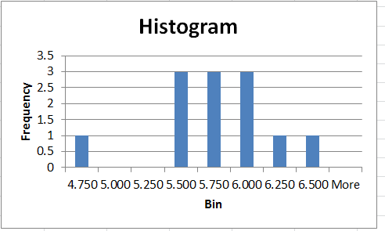
Histogram
Format Histogram
Rotate height text
Select height numbers on chart
Double click on selection
Notes:
There are many ways to reformat charts within Excel. The following slides show one option to accomplish each change in format. Other methods are possible and should be explored as you gain experience with Excel.

Slide 21
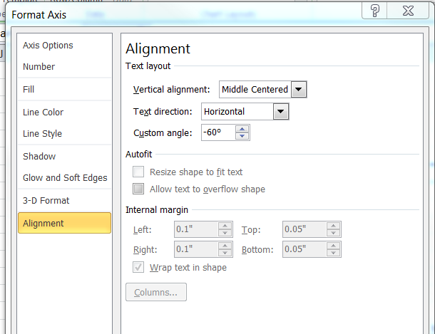
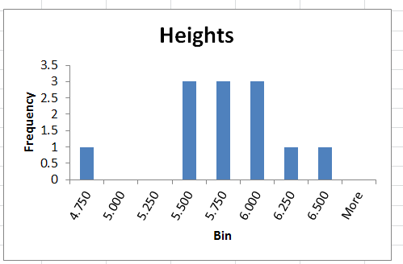
Histogram
Format Histogram
Rotate height text
Select height numbers on chart
Double click on selection
Choose Alignment
Edit Custom angle

Slide 22
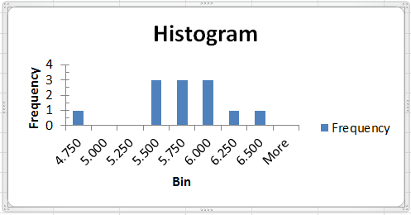
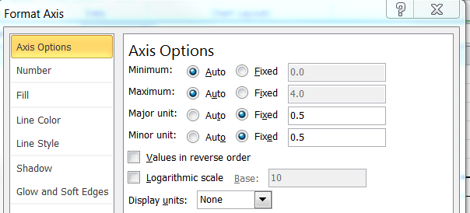
Histogram
Format Histogram
Change vertical scale
Select vertical axis numbers
Double click on selection
Select Axis Options
Change major units on vertical scale to Fixed 0.5

Slide 23
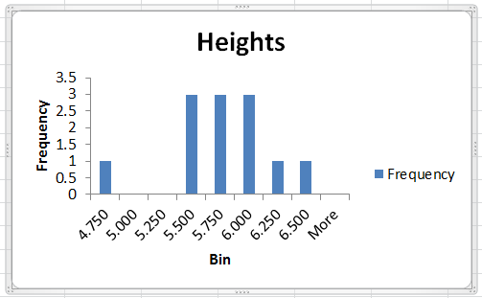
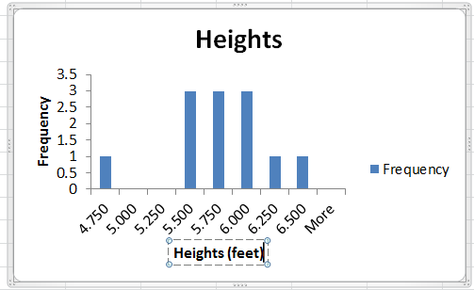
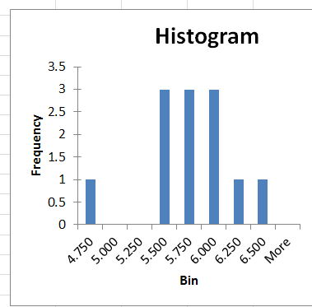
Histogram
Format Histogram
Change chart title
Select Histogram title
Revise title
Change Axis label
Select horizontal axis label
Revise text

Slide 24
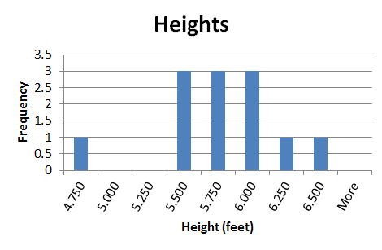
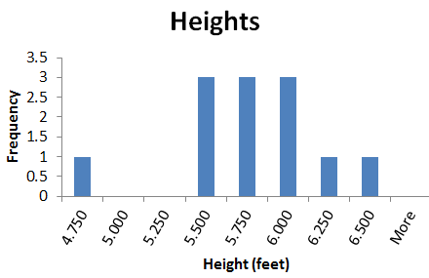
Histogram
Format Histogram
Add gridlines
Select Histogram
From Layout tab in Chart Tools
Choose Gridlines
Choose Primary Horizontal Gridlines
Choose Major Gridlines

Slide 25
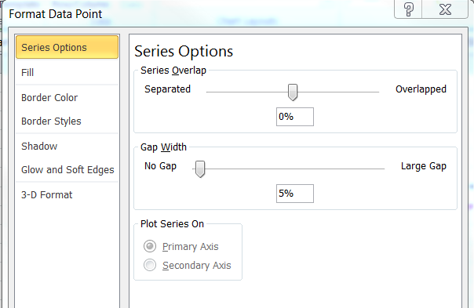
Histogram
Format Histogram
Remove gaps between bars
Select a bar
Double click on selection
Choose Series Options
Set Gap Width to 5%

Slide 26
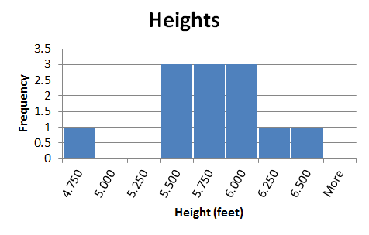
Histogram
Notes:
Final Histogram

Slide 27
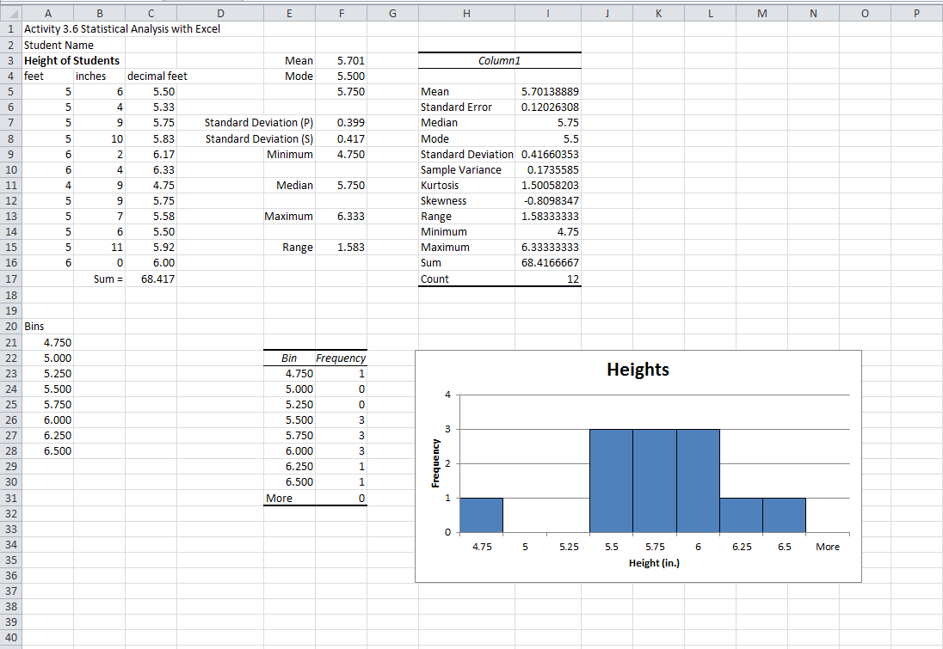
Excel Worksheet

