Slide 1
Writing a Design Brief

Slide 2
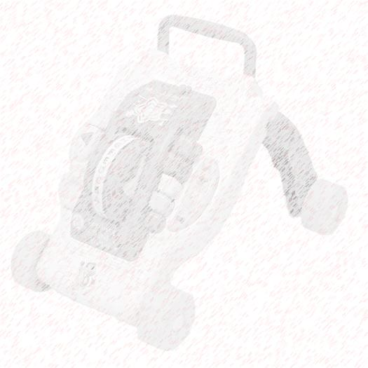
Writing a Design Brief
People are constantly surrounded by objects that compete for their attention.
What were the designers thinking when they created these objects? What purposes do their creations serve, and what problems do they address?

Slide 3
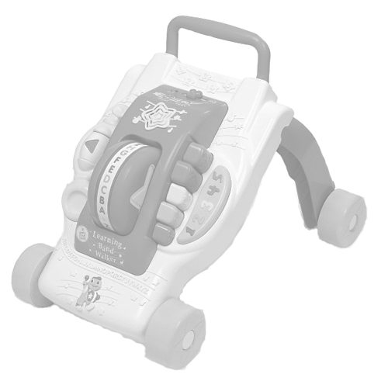
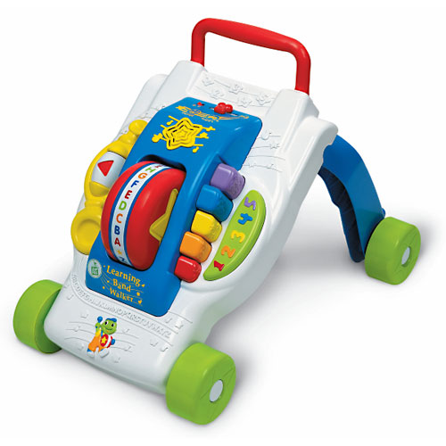
Question #1:
What are the features of the product?
made from plastic
contains cartoon images
movable
multi-colored

Slide 4
Question #1:
What are the features of the product?
Musical
tones

Slide 5
Question #1:
What are the features of the product?
sequential alphabet wheel

Slide 6
Question #1:
What are the features of the product?
simple shapes wheel

Slide 7
Question #1:
What are the features of the product?
numbers

Slide 8
Question #1:
What are the features of the product?
castors

Slide 9
Question #1:
What are the features of the product?
foldable rear legs

Slide 10
Question #1:
What are the features of the product?
grab bar

Slide 11
Question #2:
What purpose does the product serve?

Slide 12
Question #2:
What purpose does the product serve?
An infant might use the toy as a learning/play-center. The product also appears to convert into a walker, and might be used to help a toddler balance upright as he/she begins to walk. Therefore, the product may be a combination play-center/walker.

Slide 13
Question #3:
What issues might the product address?
Children need to prepare for school.
Parents need toys to keep their children occupied.
Children quickly outgrow their toys.
Children need toys to help them develop their cognitive abilities and fine motor skills.

Slide 14
Question #4:
What might the design brief look like?

Slide 15
Question #4:
What might the design brief look like?
Client / End User / Target Consumer
Problem Statement
Design Statement
Constraints

Slide 16
Question #4:
What might the design brief look like?
Client / End User / Target Consumer
Problem Statement
Design Statement
Constraints

Slide 17
Who might the Client be?
A large toy manufacturer, such as Playskool™, Fisher Price™, Leap Frog™, etc.
Who was the Target Consumer?
Obviously, a child is the end user, but a person (parent, family member, or family friend) considering the purchase of an educational toy for an infant or toddler would be the target consumer.

Slide 18
The Client

Slide 19
Target Consumer
Note:
Often the target consumer and the client are one in the same. Since it is very difficult to know who the actual designer was, that portion has been omitted for this example.

Slide 20
Question #4:
What might the design brief look like?
Client / End User / Target Consumer
Problem Statement
Design Statement
Constraints

Slide 21
What could the Problem Statement have looked like?
Most parents expect their children to be able to walk, talk, sing, count and recite the alphabet before entering elementary school. A growing expectation is that infants and toddlers will develop cognitive abilities and fine motor skills during the first three years of life.

Slide 22
Problem Statement

Slide 23
Question #4:
What might the design brief look like?
Client / End User / Target Consumer
Problem Statement
Design Statement
Constraints

Slide 24
What could the Design Statement have looked like?
Design, market, test, and mass produce a multi-function educational toy that is an infant activity center and a toddler walking aid.

Slide 25
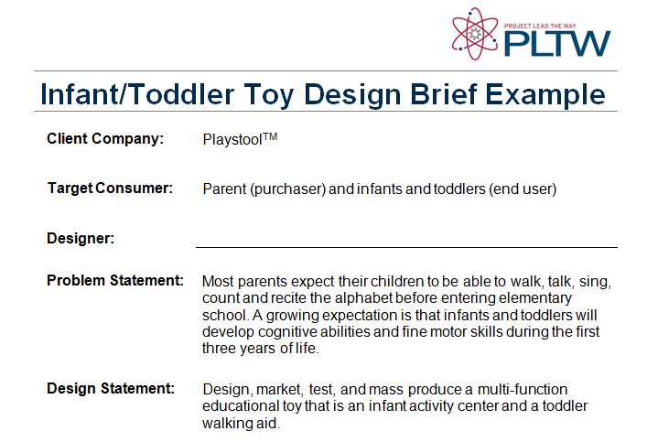
Design Statement

Slide 26
Question #4:
What might the design brief look like?
Client / End User / Target Consumer
Problem Statement
Design Statement
Constraints

Slide 27
What might the Constraints have been?
Easy to assemble
Visually stimulating to a child
Contains multiple shapes, numbers and letters
Plays music
Complies with all applicable health and safety codes
Easy to clean

Slide 28
What might the Constraints have been?
Easy to configure to infant or toddler mode
Weighs less than 4 lb
Retail price less than $20
Parts are primarily injection moldings

Slide 29
Constraints

