Slide 1
POE Unit 1.2
Energy Systems
Principles of Engineering
© 2012 Project Lead The Way, Inc.

Slide 2
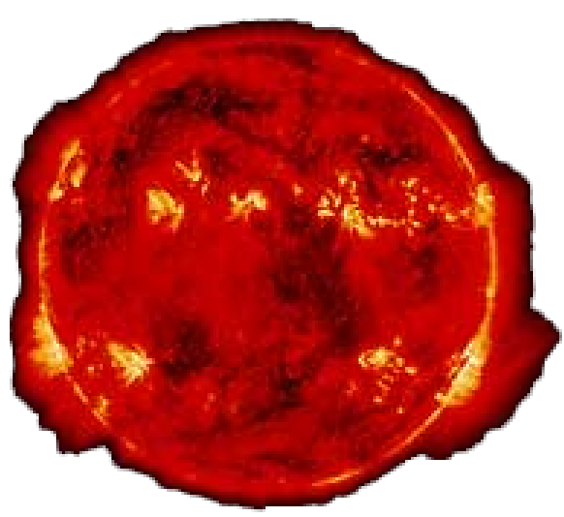
Energy Sources
Energy: The ability to do work
Energy sources are defined as
  Nonrenewable
  Renewable
  Inexhaustible
The SUN is the original source
of almost all energy sources on Earth.

Slide 3
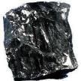
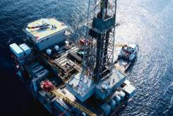
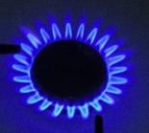
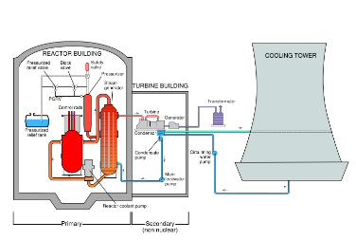
Nonrenewable Energy Sources
Sources that cannot be replaced once used
Fossil Fuels
Coal
Oil
Natural Gas
Uranium
Nuclear energy (fission)
Produces 20% of the world’s electricity
Notes:
Most of our energy needs are currently met by using fossil fuels.

Slide 4
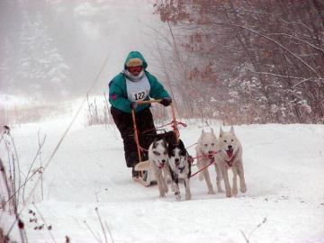
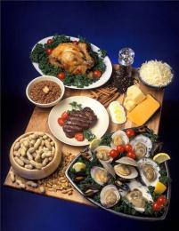
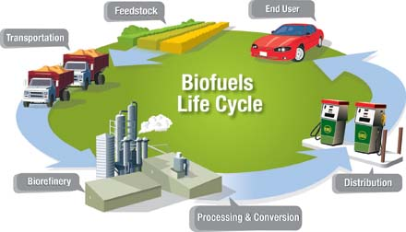
Renewable Energy Sources
Sources that can be replaced once used
Animals
Food
Biomass
  Biofuel
    Ethanol
    Methanol
U.S. Department of Energy
Notes:
Animals have been used throughout history to perform work and in some countries still provide power. This is especially true for field work.
Energy from food supplies humans and animals with the necessary energy.
Biomass includes plant materials and animal waste used especially as a source of fuel. Historically, burning wood has been the most common method of using plant material for fuel. Fuel that is used for transportation is generally referred to as biofuel.
Ethanol that comes from crops like corn and sugar cane can be used as fuel in internal combustion engines. Ethanol fuel can be purchased at several pumps as E85, which means that 85% ethanol and 15% gasoline comprise the fuel.
Methanol can be made from coal or biomass substances.

Slide 5
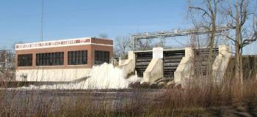
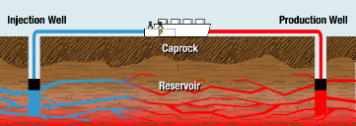
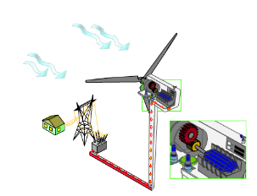
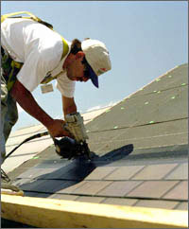
Inexhaustible Energy Sources
Hydroelectric
Tidal
Geothermal
Wind
Solar
Notes:
Hydroelectric energy production uses the flow of water from waterfalls and dams to produce electricity.
The incoming and outgoing tide caused by the gravitational pull from the moon can be used in two ways. One is to simply harness the energy as it flows in and out. Another is to capture the water with a dam at high tide and then release its potential energy in a controlled fashion, much like a facility would operate a reservoir.

Slide 6
Electricity
Movement of electrons
When applied, can provide light, heat, sound, motion . . .
Electrical Circuit
A system of conductors and components forming a complete path for current to travel
Properties of an electrical circuit include
Voltage Volts V
Current Amps A
Resistance Ohms Ω

Slide 7
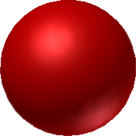
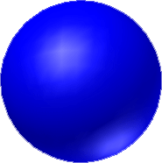
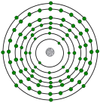

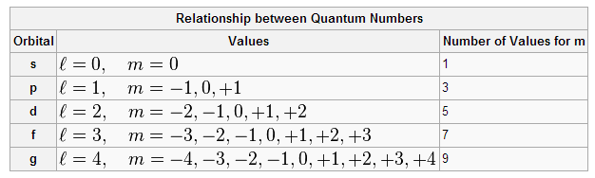
Components of an Atom (Vocab)
Electricity at the Atomic Level
Nucleus
Protons
Neutrons
Atomic Number
Electrons
Electron Orbitals
Valence Electrons

Slide 8
Conductors and Insulators
Conductors | Insulators
Electrons flow easily between atoms
1–3 valence electrons in outer orbit
Examples: Silver, Copper, Gold, Aluminum
Electron flow is difficult between atoms
5–8 valence electrons in outer orbit
Examples: Mica, Glass, Quartz

Slide 9
Water Circuit
Tank of water is like a battery.
Flow of water is current
Pipes are like wires
Rock provides resistance
Faucet is like a switch
Tank (Battery)
Faucet (Switch)
Pipe (Wiring)
Current – Amperes (A) – Flow of current
Voltage – Volts (V) – Force / Pressure that causes the flow
Resistance – Ohms(Ω) – Opposition to flow
Notes:
All materials have resistance. Conductors have little resistance. Insulators provide a lot of resistance. Some electronic components (resistors) have a specific resistance. These are often needed to reduce current in order to protect other components or to adjust the amount of current that goes to other components.

Slide 10
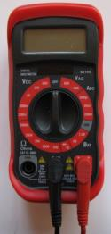
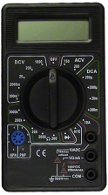
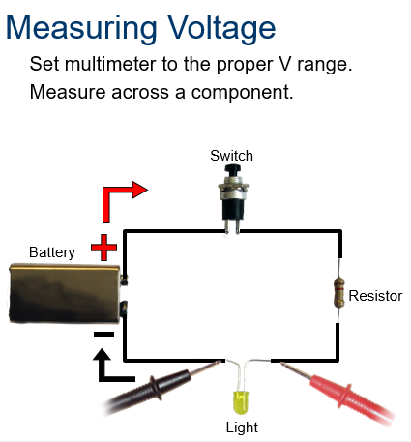
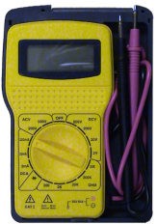
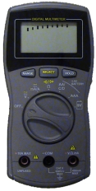
Multimeter
An instrument used to measure the properties of an electrical circuit.
Notes:
The positive and negative signs represent polarity and flow.
A digital multimeter will give a negative reading if the positive and negative terminals are reversed.
The voltage reading can be different between any measured component.

Slide 11
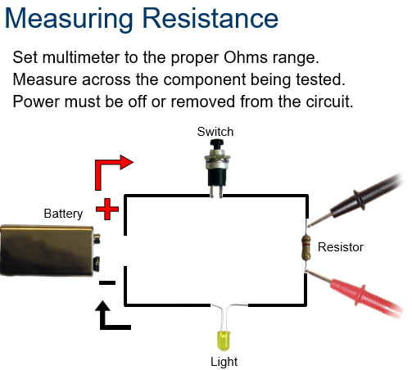
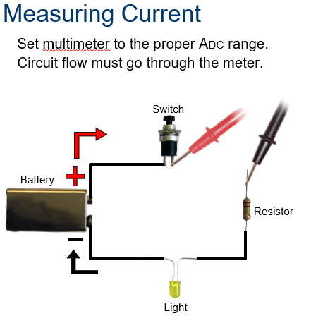
Multimeter
An instrument used to measure the properties of an electrical circuit.
Notes:
The positive and negative signs represent polarity and flow.
A digital multimeter will give a negative reading if the positive and negative terminals are reversed.
The voltage reading can be different between any measured component.

Slide 12
Circuit Configuration
Components in a circuit can be connected in one of two ways.
Series Circuits
Components are connected end-to-end.
There is only a single path for current to flow.
Parallel Circuits
Both ends of the components are connected together.
There are multiple paths for current to flow.
Components
(i.e., resistors, batteries, capacitors, etc.)
Notes:
Overview of series and parallel component configuration.

Slide 13
Ohm’s Law
The mathematical relationship between current, voltage, and resistance
V
I
R
If you know two of the three quantities, you can solve for the third.
Quantities | Abbreviations | Units | Symbols
Voltage | V | Volts | V
Current | I | Amperes | A
Resistance | R | Ohms | Ω
V=IR
I=V/R
R=V/I

Slide 14
Kirchhoff’s Laws
Kirchhoff’s Voltage Law (KVL):
  The sum of all voltage drops in a series circuit equals the total applied voltage
Kirchhoff’s Current Law (KCL):
  The total current in a parallel circuit equals the sum of the individual branch currents

Slide 15
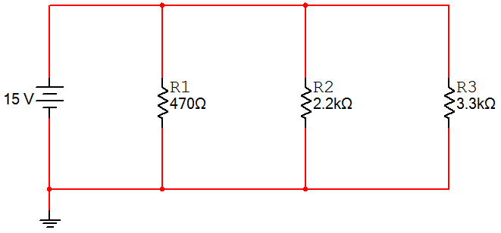
Parallel Circuits
Characteristics of a Parallel Circuit
The voltage across every parallel component is equal.
The total resistance (R_{T}) is equal to the reciprocal of the sum of the reciprocal:
The sum of all of the currents in each branch (I_{R1} + I_{R2} + I_{R3}) is equal to the total current (I_{T}). This is called Kirchhoff’s Current Law.
I_{T}
+
+
+
+
V_{T}
V_{R1}
V_{R2}
V_{R3}
-
-
-
-
R_{T}
Notes:
Characteristics of a parallel circuit.

Slide 16
Electrical Power
Electrical power is directly related to the amount of current and voltage within a system.
Power is measured in watts

Slide 17
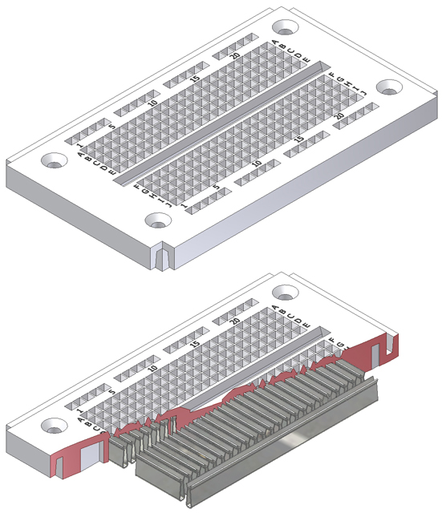
How a Breadboard Works
Electric component leads and the wire used to connect them are inserted into holes that are arranged in a grid pattern on the surface of the breadboard.
A series of internal metal strips serve as jumper wires. They connect specific rows of holes.
Top View
Cut-Away View

Slide 18
Why Breadboard?
It takes less time (and money)
Complements circuit simulation, breadboarding lets you see how, and if, the circuit functions.
Breadboards give you the ability to quickly change resistors or capacitors of different values.
A breadboard allows for easy modifications of a circuit to allow for measurements of voltage, current, or resistance.

Slide 19
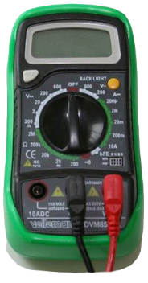

Determining a Resistor’s Value
Color Code
Measured Value
Resistors are labeled with color bands that specify the resistor’s nominal value.
The nominal value is the resistor’s face value.
A digital multimeter can measure the resistor’s actual resistance value.

Slide 20
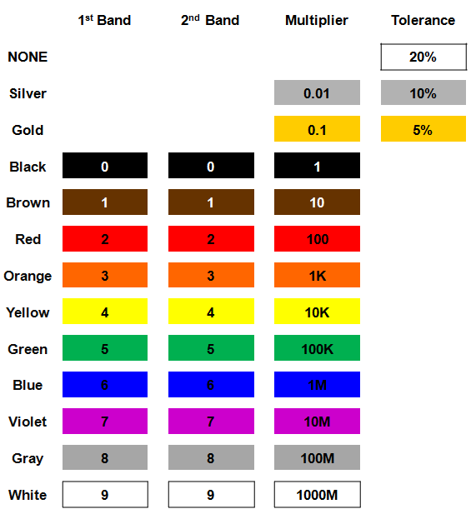

Resistor Value: Example #1
Example:
  Determine the nominal value for the resistor shown.
Solution:
  10 x 100 Ω ±5%
  1000 Ω ±5%
  1 K Ω ±5%
Notes:
This slide includes the solution to Resistor Value Example #1. If you print handouts, do not print this page.

Slide 21
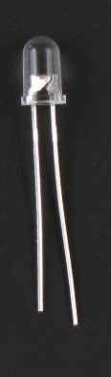
Diode
Allows current to flow in only one direction
Negative ( - ) lead
Larger metal component
inside of case or case flat spot is cathode or
negative (-) lead
Schematic Symbol
Shorter wire is cathode or
negative (-) lead

Slide 22
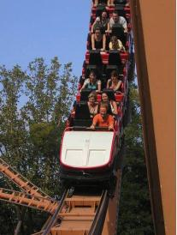
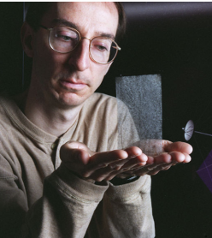
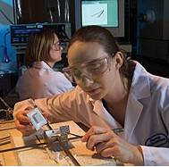
Energy
Ability to do work
Light, heat, mechanical, chemical, and electrical forms of energy can all be used to exert a force for a distance.
Roller coaster
NASA solar sail
Fuel cell

Slide 23
Forms of Energy
Potential Energy (Stored energy, often referring to gravitational potential energy)
The capacity to do work by virtue of position or configuration
Kinetic Energy (Energy of motion)
Energy which a body possesses because of its motion, which occurs anywhere from an atomic level to that of a whole organism
Notes:
Placing an object “upstream” against any of the four forces of the universe (gravity, electromagnetic, strong, and weak forces) gives the object potential energy.
Examples of potential energy:
Gravitational potential energy—Lifting an object away from the earth’s surface gives the object gravitational potential energy because the object has moved against the earth’s gravity.
Elastic energy—Stretching a rubber band gives the rubber band electromagnetic potential energy because the rubber band's molecules have been forced apart, overcoming the molecules’ electromagnetic attraction.
Electrical energy—Applying a voltage to a conductor gives the conductor electromagnetic energy because the electrons have not yet “given in” to the electromagnetic force.
Chemical energy—The electrons in molecules of fuel have electromagnetic potential energy because they have not yet “fallen” closer to the nuclei of the product that can be formed during combustion.
Thermal or Heat Energy—Changes among solid, liquid, and gaseous states are electromagnetic potential energy because the molecules have overcome the attraction between electrons in one molecule and the nuclei of neighboring molecules.

Slide 24




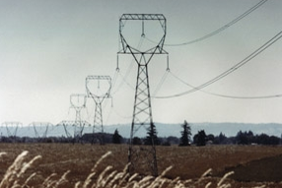
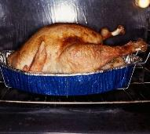
Energy Transformation
Chemical → Kinetic
Radiant → Chemical
Electrical → Thermal
Notes:
Energy transformation involves the conversion of one form of energy into another form.
Examples of energy transformation include:
Chemical to Kinetic—Food is consumed and converted into motion for playing sports or taking a test.
Radiant to Chemical—Sunlight is consumed by plants and converted into energy for growth.
Electrical to Thermal—Energy transferred to an oven is converted to thermal energy for heating our food.

Slide 25
Conservation of Energy
Energy cannot be created or destroyed, but it can change from one form to another.
Energy “Lost” to Heat
When an input energy is changed to an output energy, some of the output is usually heat energy.
Notes:
These are the First and Second Laws of Thermodynamics. Why is “lost” in quotation marks? Because energy is never lost; it is only transformed into heat. This is often “lost” because—unless there is a lower temperature to where the heat energy can flow—it cannot be transformed back into another form. Even if there is colder reservoir for the heat to flow to, the Second Law of Thermodynamics puts an upper limit (100% - T_cold/T_hot) on how much of the heat energy can be transformed back into another form.
“Conservation” also has a second meaning: “trying to make do with less.” In this common meaning, for instance, we conserve energy by setting our thermostat to a colder temperature for heating in the winter and a warmer temperature for air conditioning in the summer.

Slide 26
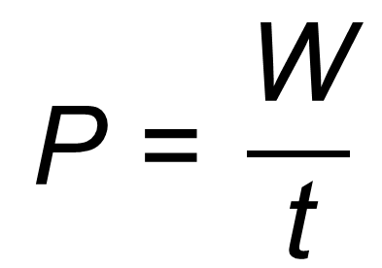
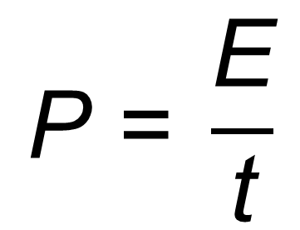
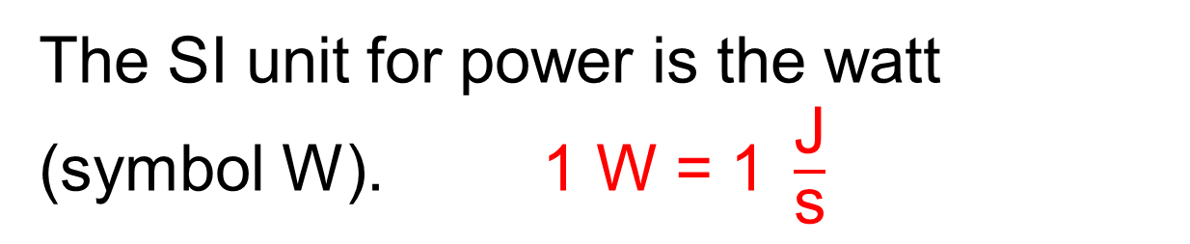
Power
Power (symbol P) is the rate at which energy E is expended or work W is performed in time t.
$$\text{P}\text{ = }\frac{\text{E}}{\text{t}}$$
$$\text{P}\text{ = }\frac{\text{W}}{\text{t}}$$
or
Power = Torque x Angular Speed
P = τ • ω
The SI unit for power is the watt (symbol W). $\text{1 }\text{W}\text{ = 1 }\frac{\text{J}}{\text{s}}$
Notes:
Both work and watt are abbreviated W. Since the watt is a unit, it will only appear next to a number, whereas work is a variable and only appears with a number if being multiplied by some other quantity.

Slide 27
Types of Power
Electrical Power
Uses electrical energy to do work
Mechanical Power
Uses mechanical energy to do work (linear, rotary)
Fluid Power
Uses energy transferred by liquids (hydraulic) and gases (pneumatic)

Slide 28
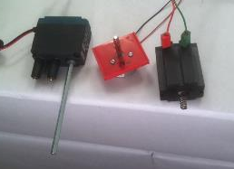
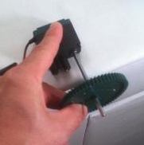
Speed Depends on Load Torque
When a motor is loaded with no torque, it spins at no-load speed, ω_{0 .}
ω₀ = no-load speed
When a motor is loaded with the stall torque τ_{stall} or more, the motor will stop.
τ_{stall} = stall torque
Notes:
The lower-case Greek letter omega is the symbol used for angular speed. Angular speed is measured in units of angle measure per time, like rotations per minute, revolutions per second, degrees per second, or radians per second. Radians per second is the SI unit for angular speed.
The lower-case Greek letter tau is the symbol used for torque. Torque is measured in units of distance times a force, like pound-inches, or newton-meters. Newton-meters is the SI unit for torque. Because the distance and force are in perpendicular directions, it cannot be simplified to units of energy; newton-meters is joules, however, when the force and distance are in the same direction.

Slide 29
Optional slide for the genius:
Speed vs. Torque Depends on Voltage
Speed ω
5 V
7 V
motor speed 120
3 V
motor speed 90
motor speed 60
Torque τ
Notes:
This slide shows how speed and torque depend on voltage. For now we’ll skip it and come back to it in Lesson 3.1 when we look at how the VEX®/fischertechnik controllers set the motor speed.
When you’re ready to dive in:
The graph in the previous slide describes the motor’s behavior at one specific voltage. This figure shows three different speed-versus-torque graphs, one for each of three different voltages.
At a lower voltage, the no-load speed and the stall torque are both smaller. At every voltage, the motor will go slower if loaded with more torque; every speed-versus-torque line has a negative slope. At every voltage, the motor will go half of its no-load speed at half of its stall torque.
The VEX® Cortex controls the motor by reducing the motor voltage. Every Cortex motor setting produces a specific voltage from -7.2V to 7.2 V.
Small voltages (and small Cortex motor speeds) do not produce motion even at no-load, because there is friction inside the motor that creates some internal torque.

Slide 30
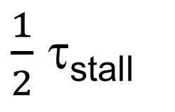
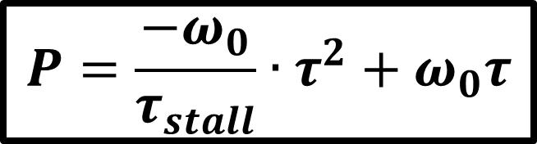
Maximum Power at Half Stall Torque
$$P=\frac{−ω_{0}}{τ_{stall}}∙τ^{2}+ω_{0}τ$$
Maximum power
Power P
$\frac{1}{2}$ τ_{stall}
No load
Stall
Torque τ
Notes:
You’ll get the most power out of your motor if it has to exert half its stall torque. Why?
Speed is linear with torque, with a negative slope.
speed = -(no-load speed/stall torque)(torque) + no-load speed
If you multiply speed by torque to get power, you find that power is a quadratic function of torque. You get a quadratic equation with a negative quadratic coefficient. That’s a parabola that opens downward. We already know that power is zero (therefore x-intercepts in the power-versus-torque graph) at zero torque and at stall torque. Since parabolas are symmetric around their vertical axis, its vertex, maximum power, must be a half the stall torque!
Power = -(no-load speed/stall torque)(torque)^2 + (no-load speed)(torque)

