Slide 1
Unit 2 Review
Introduction to Engineering Design
© 2012 Project Lead The Way, Inc.

Slide 2
Technical Sketching and Drawing
Why are technical drawings important
How do we effectively communicate our ideas graphically
Line Conventions
Drawing Styles
Line and Sketch Quality
Key vocabulary
Use of technical drawings

Slide 3
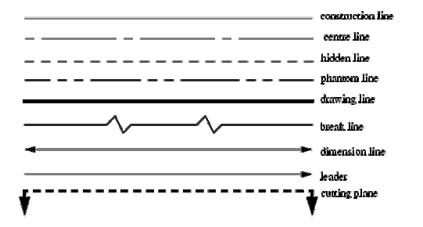
Line Conventions
Different lines have different meanings
Global standards have defined this around the world

Slide 4
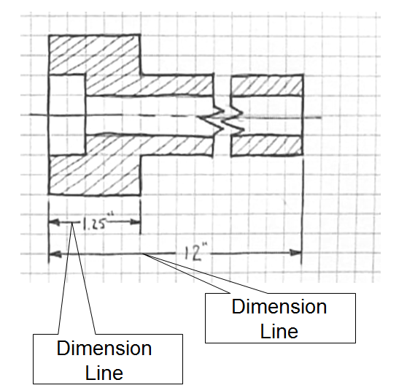
Dimensioning
Dimension Lines, combined with Extension lines, or replaced by leader lines.
Provides additional detail about our drawings
Key difference between basic sketches or art and technical drawings

Slide 5
Precedence of Lines
Complex object sketches may require different line types to overlap.
Line precedence must be used.
Rules that govern line precedence in sketches and technical drawings
Object lines take precedence over hidden and center lines.
Hidden lines take precedence over center lines.
Cutting plane lines take precedence over all others.

Slide 6
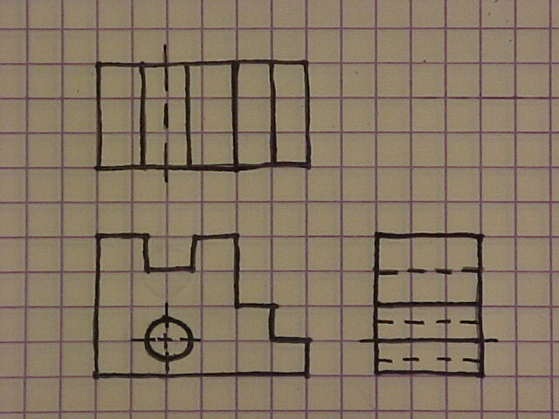
Precedence of Lines Examples
Object lines have precedence over hidden lines
Object line has
precedence over center line.

Slide 7
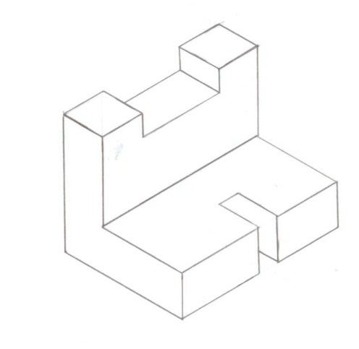
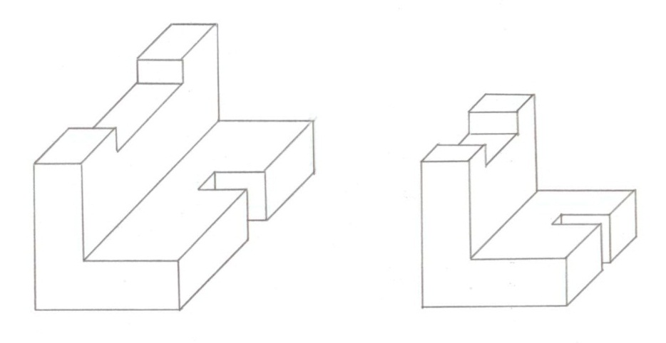
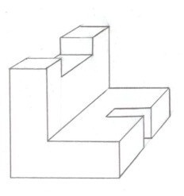
Pictorial Drawings
2D illustration of a 3D object
Difference between views
Isometric
Oblique
Perspective
Isometric
Oblique (Cavalier)
Oblique (Cabinet)
Perspective
Notes:
7

Slide 8
Oblique
Oldest form (Chinese art in the 1st century)
Flat front view, depth at 45 degree angle

Slide 9
Perspective
Developed around 1400s
Used math concepts with oblique drawings
Most artistic, but most realistic views

Slide 10
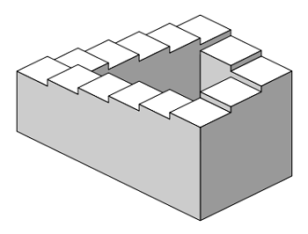
Isometric
Developed during 1800s
Commonly used in engineering
“Equal Measures”

Slide 11
Orthographic / Multiview Sketch
Sets of 2D sketches to describe 3D object
Multiview sketches are perpendicular

Slide 12
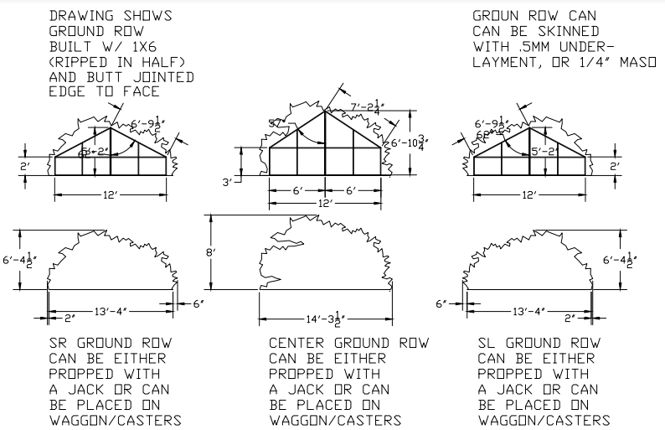
Use for manufacturing
Multiview drawings used for building theatre set pieces

Slide 13
Sketch Quality
Consider views, time, and purpose of a sketch
What steps in the design process would these apply?

Slide 14
Converting Views
What view do you need to show?
Understand how to convert from one type of drawing to another

